Slide 1
Breast Cancer Wisconsin (Diagnostic)
Predict whether the Tumor is benign or malignant
Final Presentation
John Khwajazada

Slide 2
Overview
Data has 569 lines of data
357 of the tumors are benign and 212 tumors are malignant
There are 32 attributes in this dataset
The goal of this project is to accurately predict if a tumor is cancerous or not

Slide 3
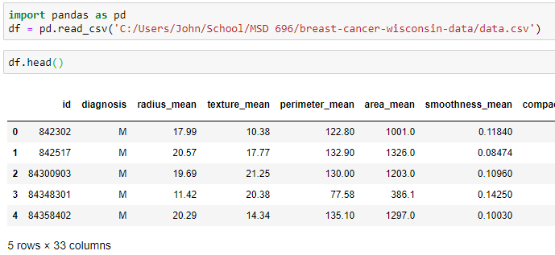
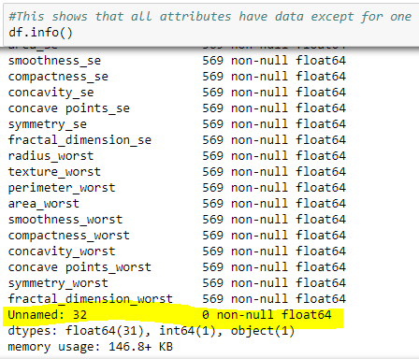
Data cleaning
We see that there is one column that is missing data, it must be removed

Slide 4
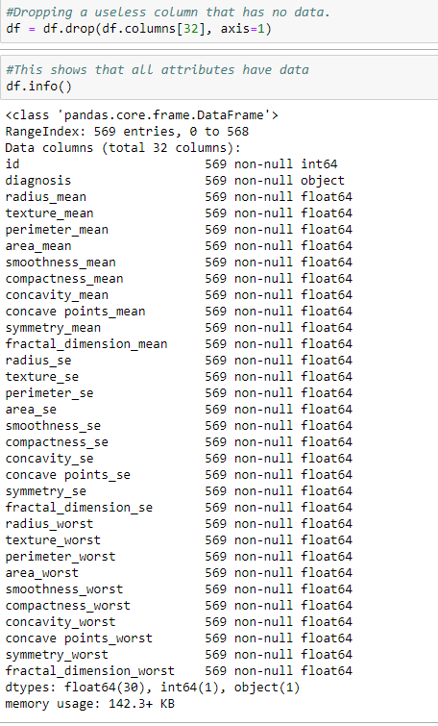
Data cleaning Continued
Here we can see that the empty column has been dropped

Slide 5
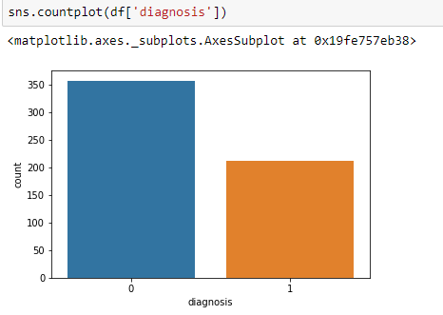
Data cleaning Continued
We need to convert the diagnosis to something we can use in our model
Here is a simple bar chart that shows the diagnosis as either a 1 as Malignant or 0 as Benign

Slide 6
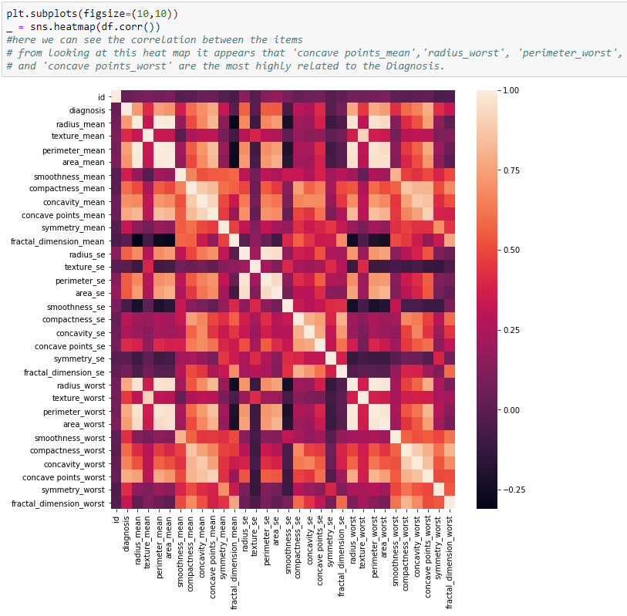
Heat Map

Slide 7
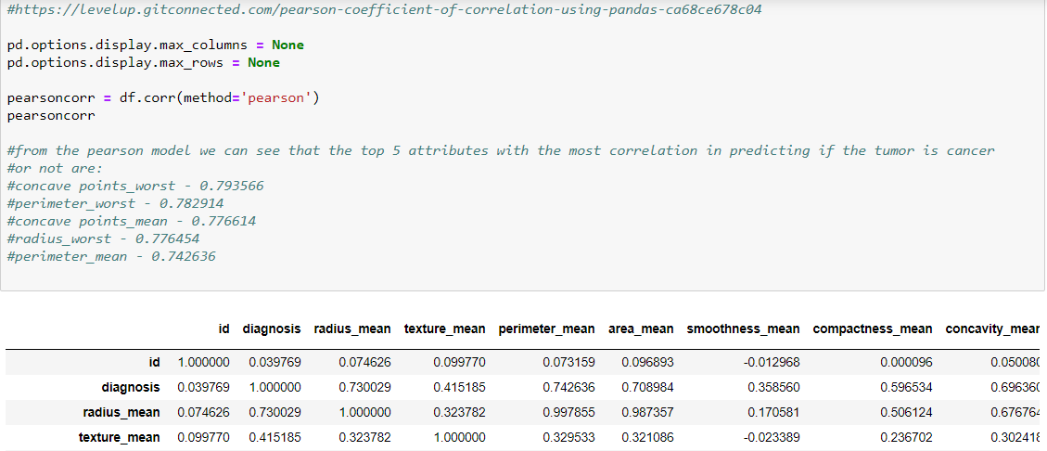
Pearson Correlation

Slide 8
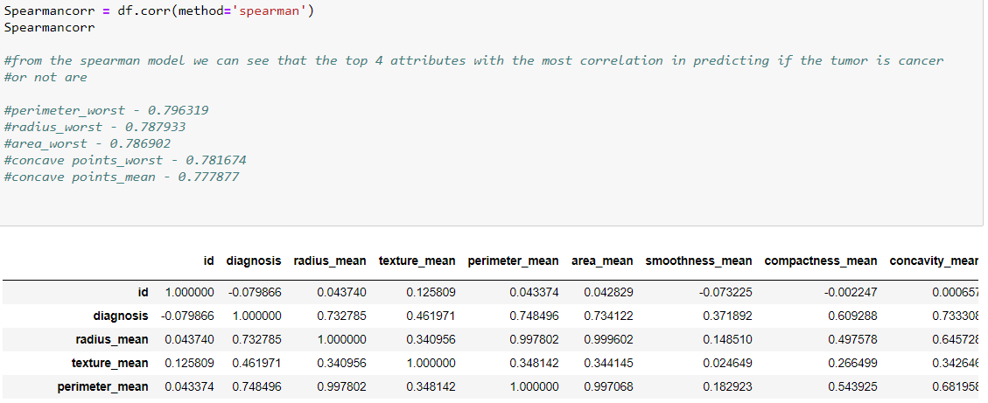
Spearman Correlation

Slide 9

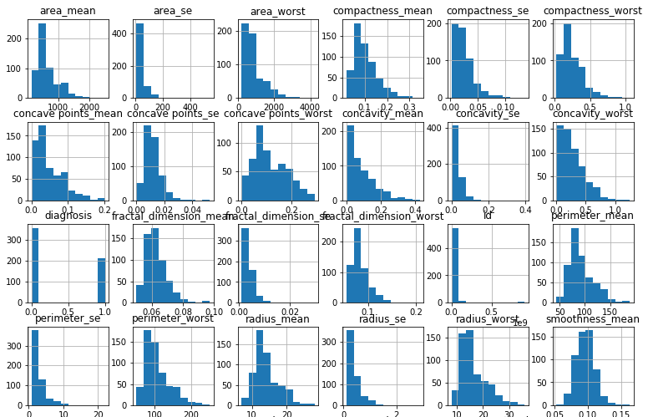
Histograms
Here is a sampling of all the attribute data plotted on histograms

Slide 10
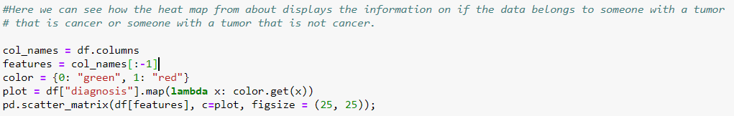
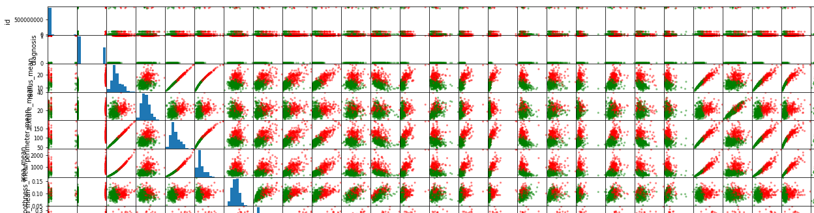
Scatter Plots
Here is a sampling of all the attribute data plotted on scatter plots and relating to if the tumor plotted is cancerous or benign

Slide 11
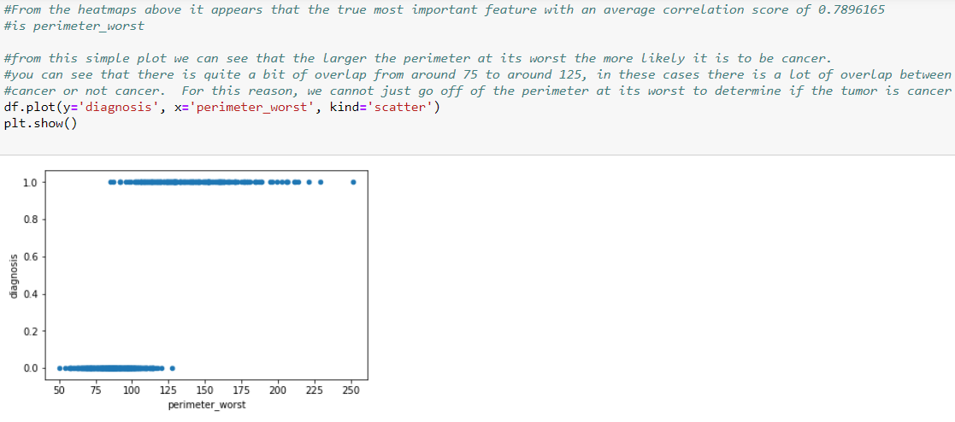
Plot of Most Important from Heat Map

Slide 12
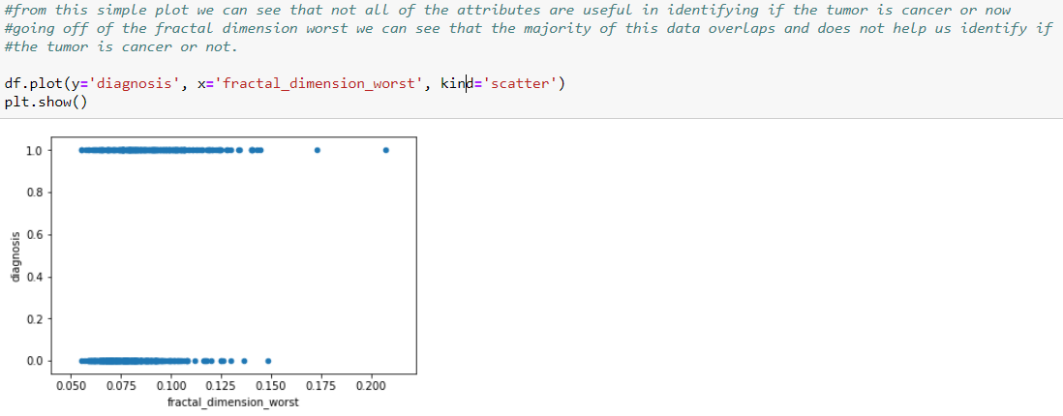
Plot one of the Least Important features from Heat Map

Slide 13
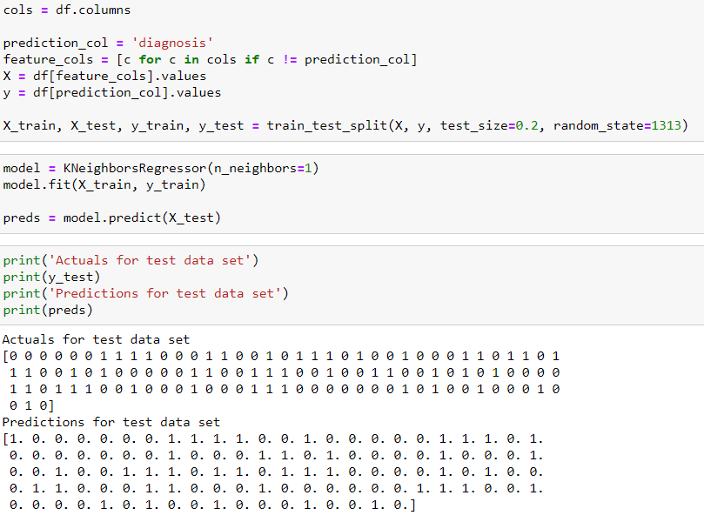
KneighborsRegressor

Slide 14
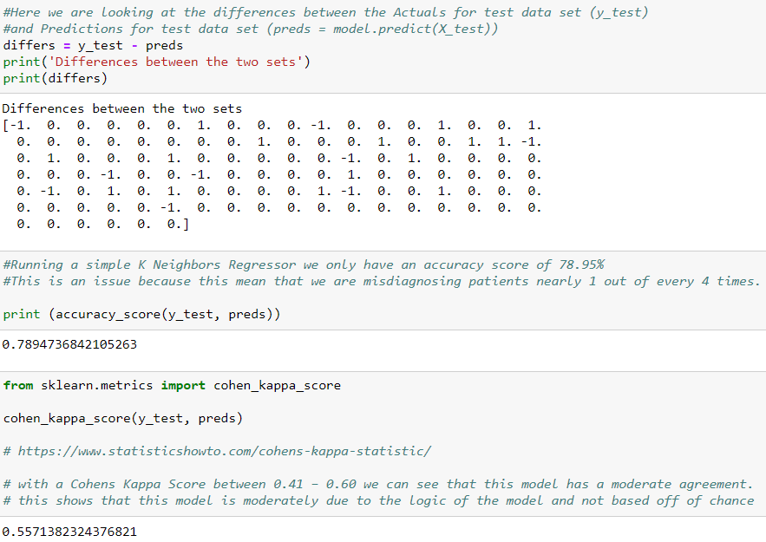
KneighborsRegressor

Slide 15
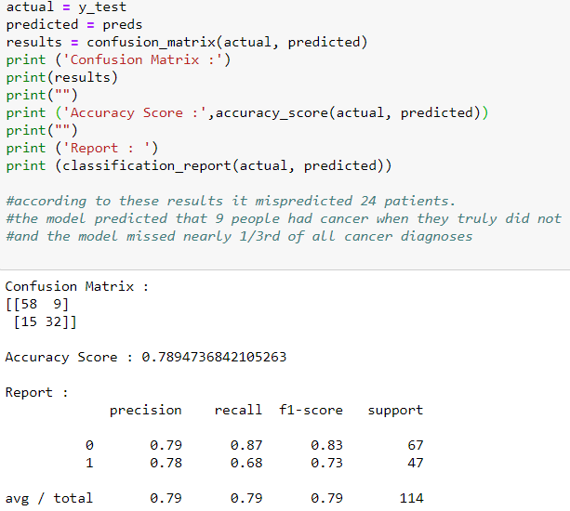
KneighborsRegressor

Slide 16
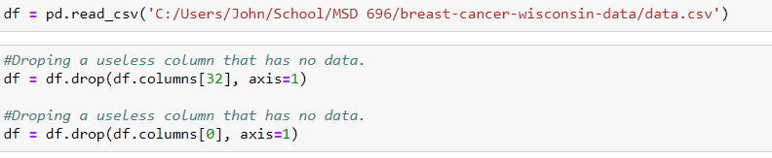
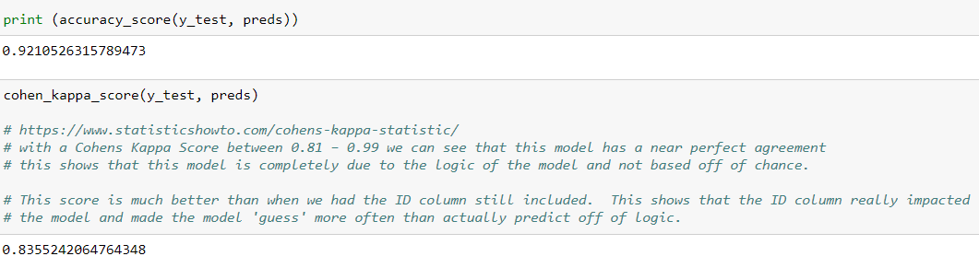
Data clean up and Rerun KneighborsRegressor
Drop ID Column
Rerun same K Neighbor Regressor

Slide 17
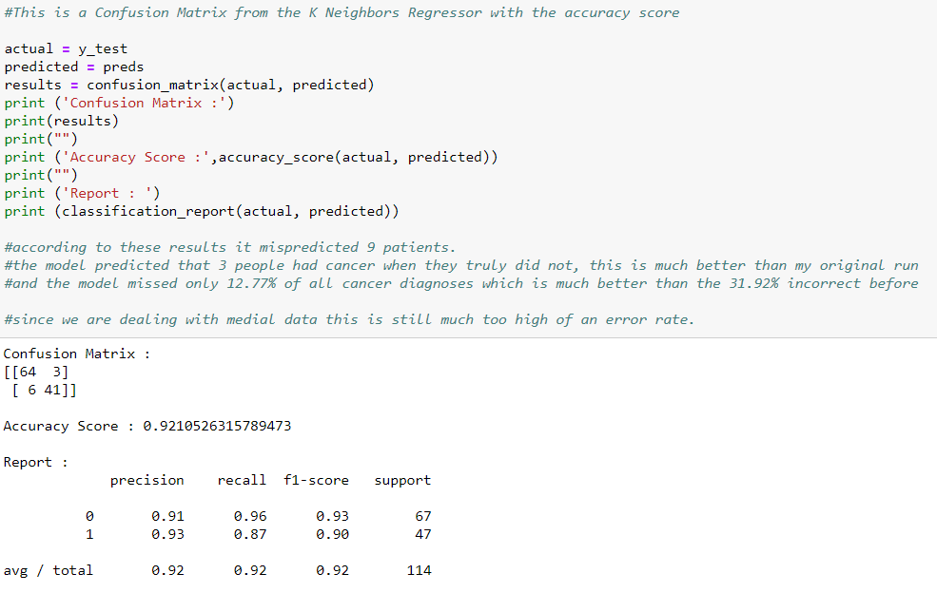
Data clean up and Rerun KneighborsRegressor

Slide 18
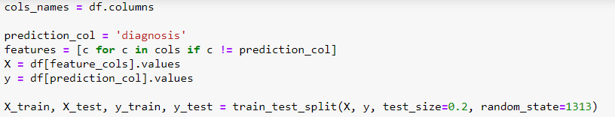
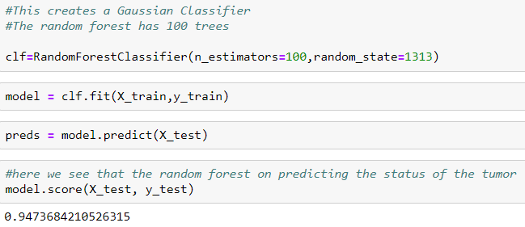
Random Forest Classifier

Slide 19
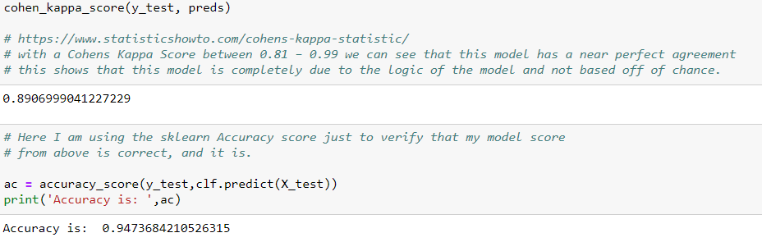
Random Forest Classifier

Slide 20
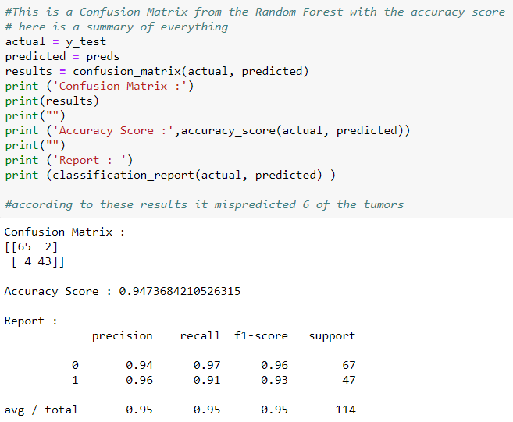
Random Forest Classifier

Slide 21
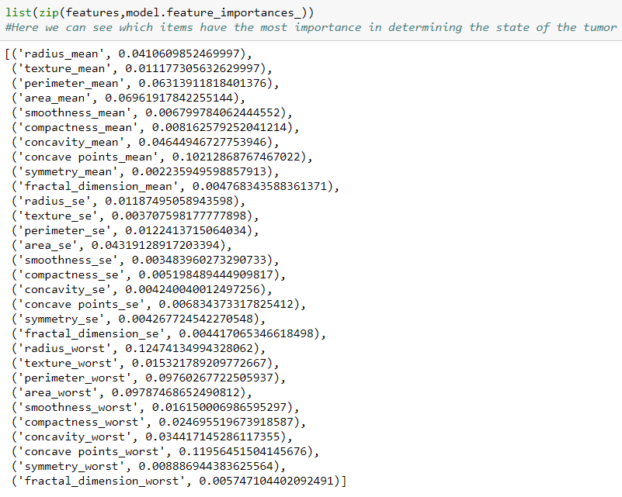
Features of Importance

Slide 22
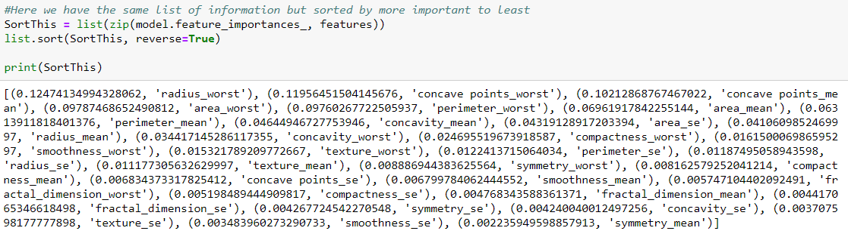
Features of Importance Ordered

Slide 23
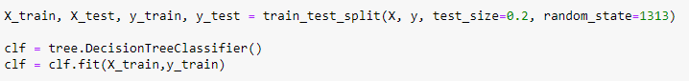
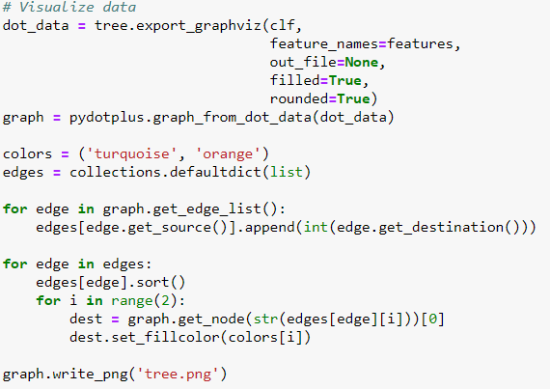
Decision Tree

Slide 24

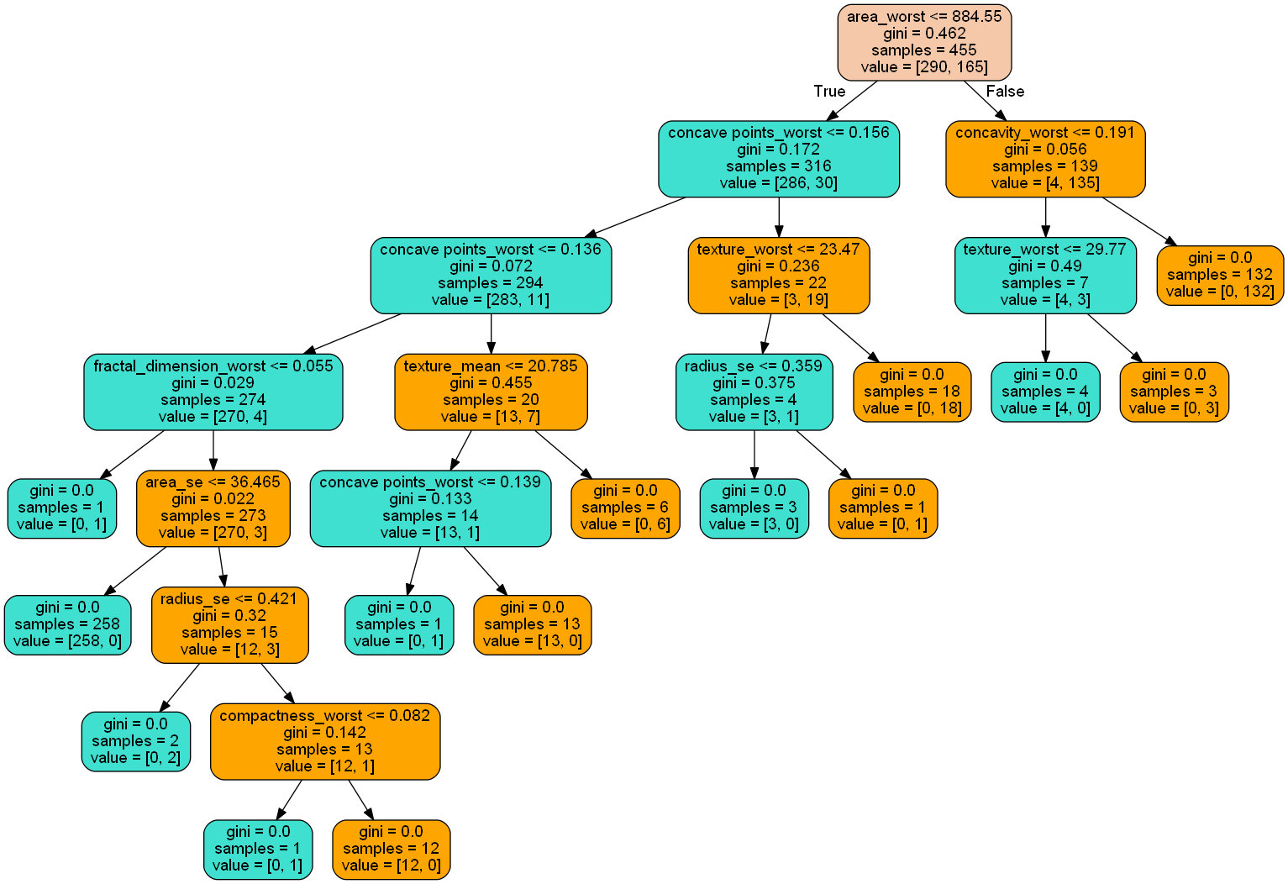
Decision Tree

Slide 25
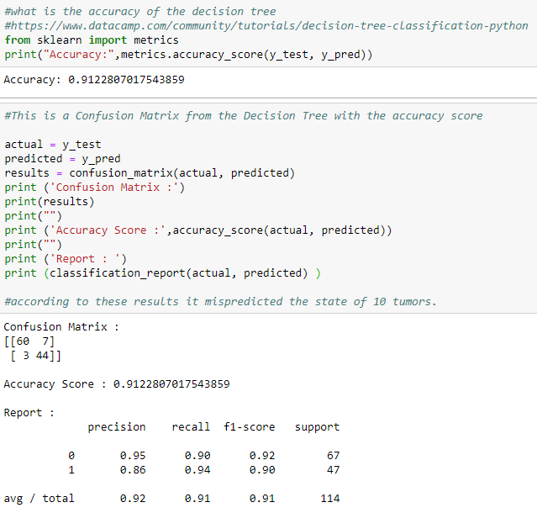
Decision Tree

Slide 26
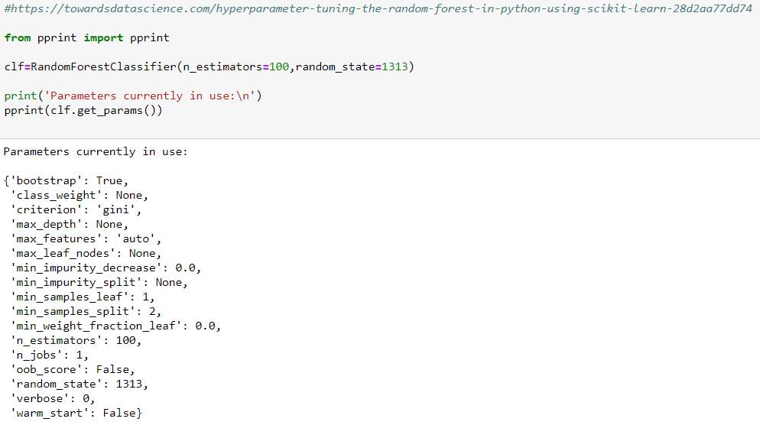
Grid Search CV

Slide 27
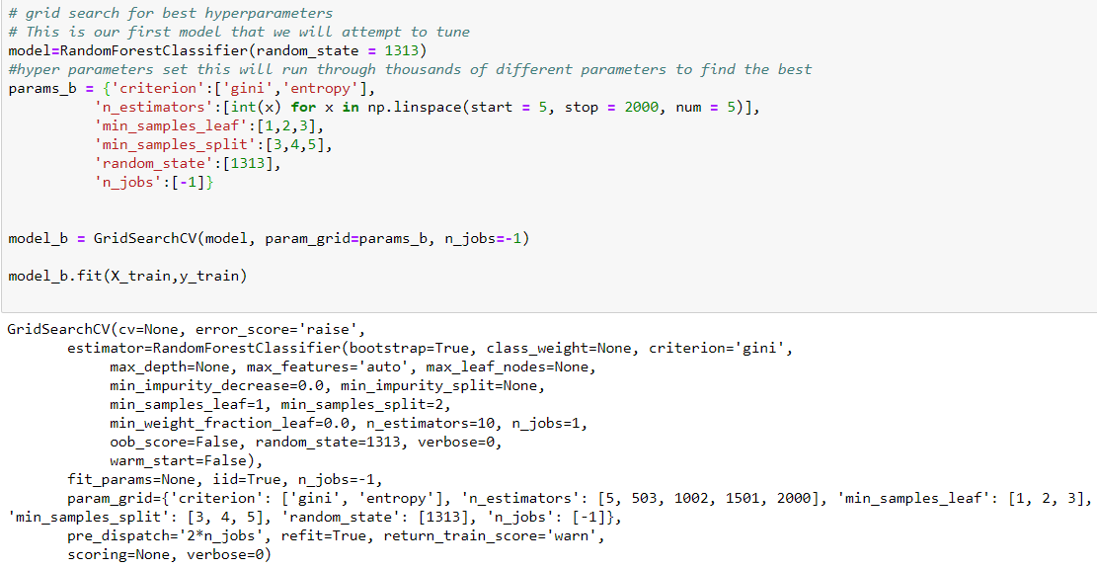
Grid Search CV

Slide 28
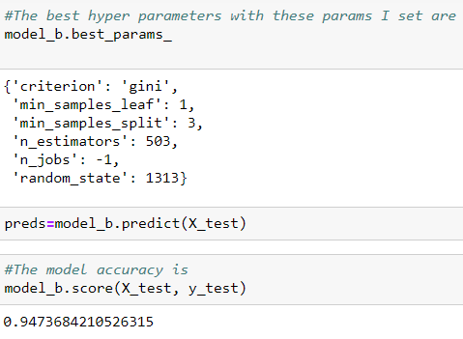
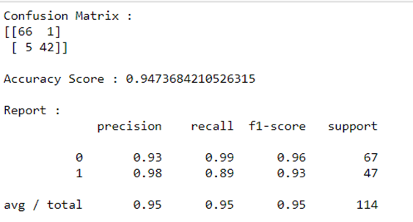
Grid Search CV

Slide 29
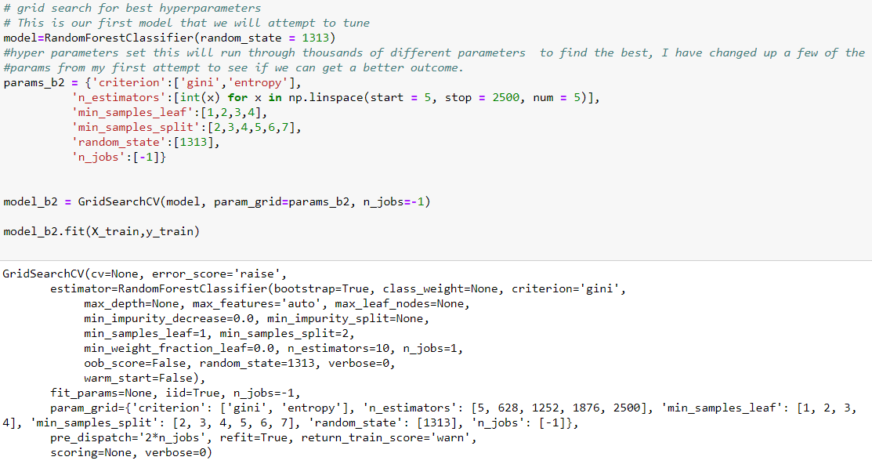
Grid Search CV

Slide 30
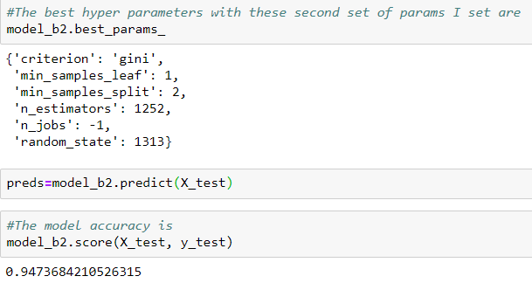
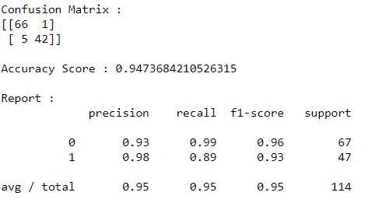
Grid Search CV

Slide 31
Conclusion
Best Model – Random Forest Classifier with accuracy of 94.74%
Limits with this model
Why hyper parameter Random Forest Classifier models are worse predictors
Ways to improve this model
Larger data set
More attributes
Risks

